Slide 1
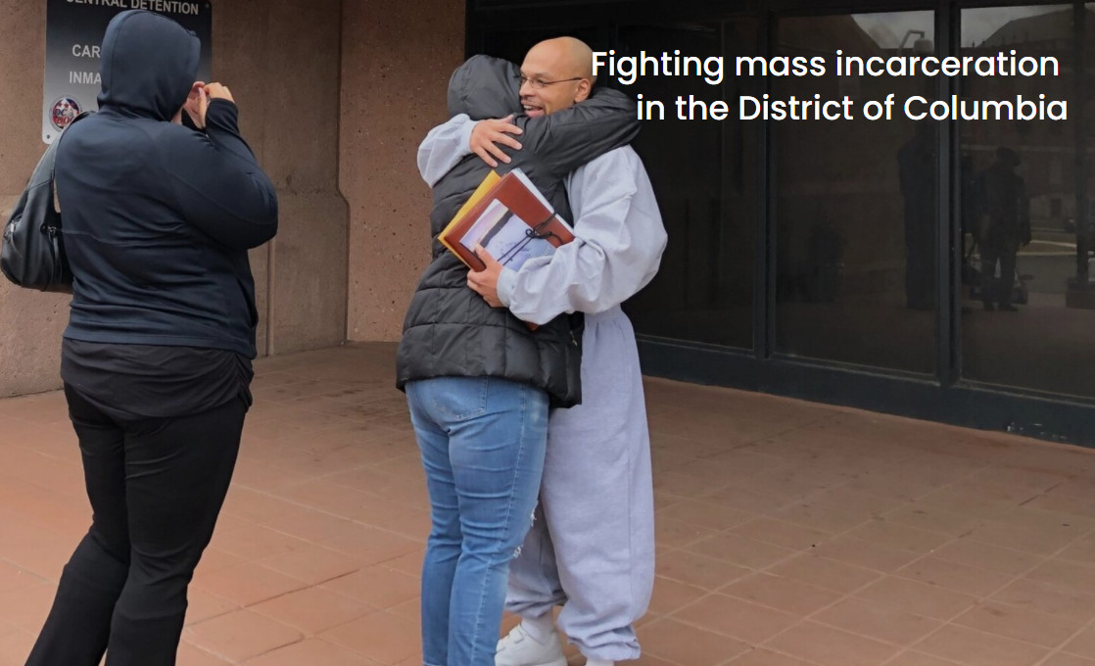
DC’s Incarceration Reduction Amendment Act
Overview
  IRAA,codified at D.C. Code § 24-403.03, creates a sentence review mechanism by which individuals serving lengthy sentences may petition the court for a sentence reduction and/or release.
Eligibility
  Under age 25 at time of offense.
  Must have served at least 15 years in prison.

Slide 2
Four U.S. Supreme Court Cases Set the Foundation for IRAA in the Eighth Amendment
The US Supreme Court decided four key cases between 2005 and 2016:
  Roper v. Simmons, 543 U.S. 551 (2005).
    Finding that a death penalty sentence for people who were under eighteen at the time of the offense violated the Eighth Amendment’s ban on cruel and unusual punishment.
  Graham v. Florida, 560 U.S. 48 (2010).
    Prohibiting life without parole for non-homicide offenses committed by children under eighteen – Eighth Amendment.
  Miller v. Alabama, 567 U.S. 460 (2012).
    Finding that mandatory life sentences in prison without the possibility of parole for juvenile homicide offenders violated the Eighth Amendment’s ban on cruel and unusual punishment.
  Montgomery v. Louisiana, 577 U.S. 190 (2016).
    Prohibiting life without parole in homicide cases for “all but the rarest of children, those whose crimes reflect ‘irreparable corruption’” (quoting Miller).

Slide 3
IRAA: Threshold Requirements For Relief
Pursuant to IRAA, the trial court (D.C. Superior Court) must make two threshold findings in order to grant relief:
  1) The individual is not a danger to the safety of any person or the community; and
  2) The interests of justice warrant a sentence reduction. D.C. Code § 24-403.03(a)(2).
The court must consider 11 factors in making these threshold findings. D.C. Code § 24-403.03(c)(1)-(11).
The defendant bears the burden of proving that (s)he is entitled to relief.

Slide 4
IRAA: Eleven-Factor Test
11 Factors a Court Must Consider in Making the Threshold Findings D.C. Code § 24-403.03(c)(1)-(11).
(1) The defendant's age at the time of the offense;
(2) The history and characteristics of the defendant;
(3) Whether the defendant has substantially complied with the rules of the institution to which the defendant has been confined, and whether the defendant has completed any educational, vocational, or other program, where available;
(4) Any report or recommendation received from the United States Attorney;
(5) Whether the defendant has demonstrated maturity, rehabilitation, and a fitness to reenter society sufficient to justify a sentence reduction;
(6) Any statement, provided orally or in writing, provided pursuant to § 23-1904 or 18 U.S.C. § 3771 by a victim of the offense for which the defendant is imprisoned, or by a family member of the victim if the victim is deceased;

Slide 5
IRAA: Eleven-Factor Test (Cont’d)
11 Factors a Court Must Consider in Making the Threshold Findings D.C. Code § 24-403.03(c)(1)-(11).
(7) Any reports of physical, mental, or psychiatric examinations of the defendant conducted by licensed health care professionals;
(8) The defendant's family and community circumstances at the time of the offense, including any history of abuse, trauma, or involvement in the child welfare system;
(9) The extent of the defendant's role in the offense and whether and to what extent another person was involved in the offense;
(10) The diminished culpability of juveniles and persons under age 25, as compared to that of older adults, and the hallmark features of youth, including immaturity, impetuosity, and failure to appreciate risks and consequences, which counsel against sentencing them to lengthy terms in prison, despite the brutality or cold-blooded nature of any particular crime, and the defendant's personal circumstances that support an aging out of crime; and
(11) Any other information the court deems relevant to its decision.

Slide 6
IRAA Initiative: Case Overview
IRAA Motion to the D.C. Superior Court
(mitigation report, reentry plan, letters of support, etc.)
Government Response
Reply Brief
Evidentiary Hearing
Grant or Denial in Writing
(if denied, can re-file in 3 years)

Slide 7
Results so far
Nearly 100 cases have been resolved
Approximately 80 people have been granted relief
Fewer than 5 grantees rearrested for any offense or probation violation
Overwhelming community support and successful reintegration

